Slide 1
CSC291 - Software Engineering Concepts
By
Dr. Junaid Akram
Assistant Professor, Department of Computer Science COMSATS (Lahore)

Slide 2
Design Process
Design Process
Design Concepts
Design Models
Chapter 8: Design Process
by “Software Engineering- A Practitioner's Approach”

Slide 3
Design
Software design encompasses the set of principles, concepts, and practices that lead to the development of a high-quality system or product.
Concept -> Practice -> software representations.
Design is where you stand with a foot in two worlds – the world of technology and the world of people and human purpose – and you try to bring the two together.
Design model provides detail about software architecture, data structures, interfaces, and components that are necessary to implement the system. It can be assessed for quality and improved before code is generated.

Slide 4
Design
After requirement modeling, it is the last action within the modeling activity that sets the stage for construction (code generation and testing).
Good software design should make sure:
Firmness: A program should not have any bugs that inhibit its function.
Commodity: A program should be suitable for the purposes for which it was intended.
Delight: The experience of using the program should be pleasurable one.

Slide 5
Requirement model → Design Model

Slide 6
Design
The data/class design transforms class models into design class realizations and the requisite data structures required to implement the software. The objects and relationships defined in the CRC (Class, Responsibility, Collaborator) diagram and the detailed data content depicted by class attributes and other notation provide the basis for the data design action.
The architectural design (framework of a computer-based system) defines the relationship between major structural elements of the software, the architectural styles and design patterns that can be used to achieve the requirements defined for the system, and the constraints that affect the way in which architecture can be implemented.

Slide 7
Design
The interface design describes how the software communicates with systems that interoperate with it, and with humans who use it. An interface implies a flow of information (data/control) and a specific type of behavior. Therefore, usage scenarios and behavioral models provide much of the information needed.
The component-level design transforms structural elements of the software architecture into a procedural description of software components. Information obtained from the class-based models, flow models, and behavioral models serve as the basis for component design.

Slide 8
Design Quality
The importance of design can be stated with a single word – quality.
Software design serves as the foundation for all the software engineering and support activities that follow.
Without design, you risk building an unstable system –
one that will fail when small changes are made;
one that may be difficult to test;
one whose quality cannot be assessed until late in the software process, when time is short and many dollars have already been spent.

Slide 9
Design Quality Attributes (FURPS)
Functionality: evaluate the feature set and capabilities of the program, the generality of the functions that are delivered , and the security of the overall system.
Usability is assessed by considering human factors.
Reliability is evaluated by measuring the frequency and severity of failure, the accuracy of output results, the mean-time-to-failure, the ability to recover form failure, and the predictability of the program.
Performance is measured by considering processing speed, response time, resource consumption, throughput, and efficiency.
Supportability combines the ability to extend the program, adaptability, serviceability, maintainability, testability, compatibility, configurability.

Slide 10
Design Process
It is an iterative process through which requirements are translated into a “blueprint” for constructing the software.
Initially, the blueprint depicts a holistic view of software. That is the design represented at a high level of abstraction- a level that can be directly traced into the specific system objective and more detailed data, functional, and behavioral requirements.
As design iteration occur, subsequent refinement leads to design representations at much lower level of abstraction with subtle connection to requirements.

Slide 11
Design Process: Characteristics of good Design
Three characteristics that serve as a guide for the evaluation of a good design.
The design must implement all of the explicit requirements contained in the analysis model, and it must accommodate all of the implicit requirements desired by the customer.
The design must be a readable, understandable guide for those who generate code and for those who test and subsequently support the software.
The design should provide a complete picture of the software, addressing the data, functional, and behavioral domains from an implementation perspective.

Slide 12
Fundamental Design Concepts
Abstraction—data, procedure, control
Architecture—the overall structure of the software
Patterns—”conveys the essence” of a proven design solution
Sub-processes—any complex problem can be more easily handled if it is subdivided into pieces
Modularity— division of data and function
Hiding— controlled interfaces
Functional independence—single-minded function
Refinement—elaboration of detail for all abstractions
Refactoring—a reorganization technique that simplifies the design
OO design Concepts– Classes, structures
Design Classes—provide design detail that will enable analysis classes to be implemented

Slide 13
Design Model

Slide 14
Design Model Elements
Data elements
Data model --> data structures
Data model --> database architecture
Architectural elements
Analysis classes, their relationships, collaborations and behaviors are transformed into design realizations
Patterns and “styles” (Chapters 9 and 12)
Interface elements
the user interface (UI)
external interfaces to other systems, devices, networks or other producers or consumers of information
internal interfaces between various design components.
Component elements
Deployment elements

Slide 15
Component Element
Describe the internal details of each software components. It defines data structure for all local data objects and algorithmic details for all processing that occurs within a component and an interface that allows access to all component operations.
Within the context of object-oriented SE, a component is represented in UML diagram as shown above. SensorManagement performs all functions associated with sensors including monitoring and configuring them.

Slide 16
Deployment Elements
How software functionality and subsystems will be allocated within the physical computing environment that will support the software.
E.g. Safehome product are configured to operate within three primary computing environments- a home-based PC, the safehome control panel, and a server housed at CPI corp.

Slide 17
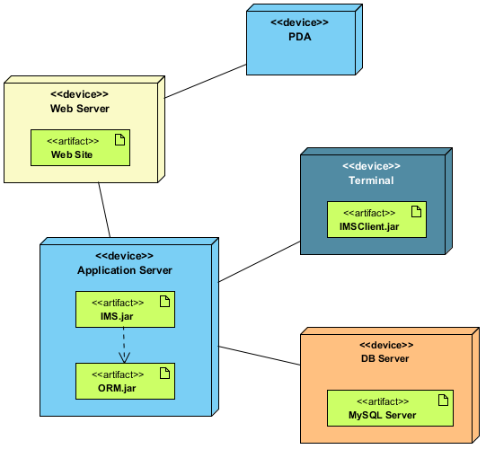
Deployment Diagram
A deployment diagram is a UML diagram type that shows the execution architecture of a system.
Deployment diagrams are typically used to visualize the physical hardware and software of a system.

Slide 18
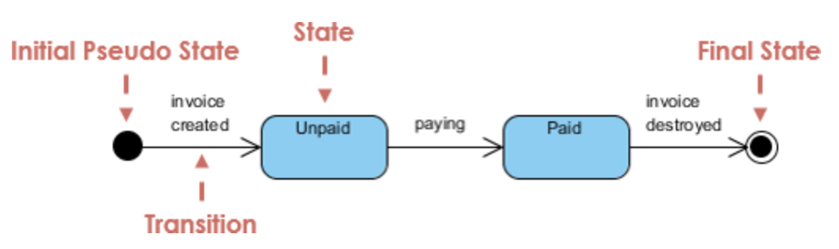
State Machine Diagram
A state machine diagram models the behaviour of a single object, specifying the sequence of events that an object goes through during its lifetime in response to events.

Slide 19

Thanks for your attention!
Any Question?
Email me on : junaidakram@cuilahore.edu.pk

